Slide 1
COGS 138: Week 5 Section
February 2nd, 2022

Slide 2
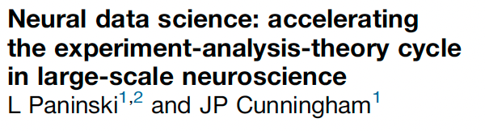
Questions about Reading #2?
Notes:
Quiz due this Friday

Slide 3
Final Project Overview
Identify questions that you can answer by using publicly available datasets
Integrate different datasets
Implement technical skills to answer your scientific questions
Work effectively with a team
Notes:
These are TANGIBLE SKILLS you can actually apply to grad school, research, and lots of industry jobs

Slide 4
What will you be turning in??
Proposal
1 page document
Pitching your question & approach
Final Project
Jupyter notebook
Steps of analysis that answers your main question
Background and discussion sections

Slide 5
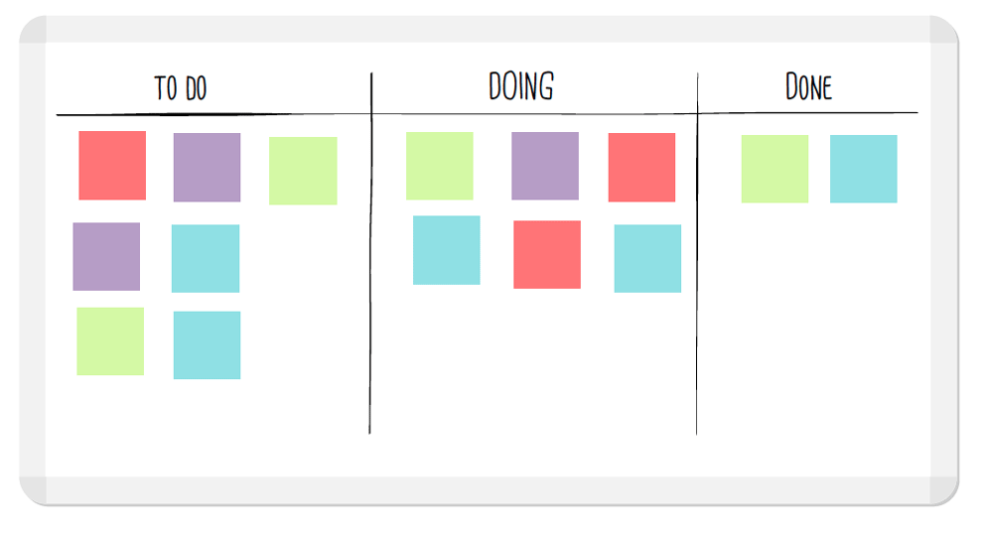
Proposal
Group member names
Experimental question
Background
Approach
Notes:
Proposal
In approximately one page, describe your main question and approach that you will take. Your
proposal should have the following elements:
I. Group member names, and your group name (optional)
II. Experimental question
One sentence that describes the question you’ll address in your proposal.
III. Background
In 2-3 paragraphs, describe the motivation behind your question. What’s the big picture, and why
is it interesting? Are there published papers addressing aspects of your question? You should cite
at least three primary references in your background. You are welcome to replicate published
papers using publicly available data.
IV. Approach
Which datasets will you use, and how will you interact with these datasets? Do you need to
compute any metrics from these data? In addition, decide on two different ways that you will
compare your, e.g., cell types or brain regions. In other words, what plots will you make with your
data? In one paragraph, describe what you’re hoping to ultimately compare.
You may organize your “Approach” section as paragraphs (1-2), or as a list. Thinking of this part
sequentially will ultimately help you design your analysis and convert that into items in the GitHub
Project Kanban board. For example, after pulling in the data from the SDK, then what will you do?

Slide 6
Final Project
Intro:
Overview, Question, Background, Hypothesis
Data Analysis:
Wrangling, Viz, Results
Conclusion:
Discussion, Limitation, Future Steps
Notes:
Introduction & Background (20%)
❏ Overview:
❏ Write a clear summary of what you did
❏ Limit overview to 3-4 sentences
❏ Research Question:
❏ Include your specific data science question
❏ Make sure what you’re measuring (variables) to answer your question is clear
❏ Background & Prior Work
❏ Include explanation of what work has been done previously
❏ Include citations or links to previous work
❏ Include an explanation of dataset(s) used (i.e., how the data was collected, features/variables included, number of observations, information in dataset)
❏ Hypothesis
❏ Include your team’s hypothesis
❏ Ensure that this hypothesis is clear to readers
❏ Explain why you think this will be the outcome (what was your thinking?)
II. Data Analysis (60%)
❏ Data Wrangling
❏ Pull your data into Python and explain steps taken to isolate the data you need
❏ Data Visualization
❏ Include at least three visualizations
❏ Clearly label all axes on plots
❏ Type of all plots appropriate given data displayed
❏ Interpretation of each visualization included in text
❏ Data Analysis & Results
❏ Appropriate analysis performed
❏ Output of analysis interpreted and interpretation included in notebook
III. Conclusion & Discussion (20%)
❏ Discussion of your results and how they address your experimental question
❏ Limitations of analysis discussed
❏ What additional experiments would be interesting, and what data would you need?

Slide 7
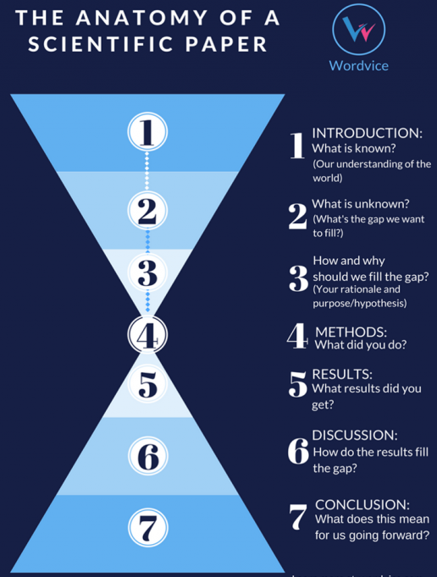
Final Project
Intro:
Overview, Question, Background, Hypothesis
Data Analysis:
Wrangling, Viz, Results
Conclusion:
Discussion, Limitation, Future Steps
Notes:
This is really similar to how an actual paper is structured!
Again, TANGIBLE skills to teach how to do research

Slide 8
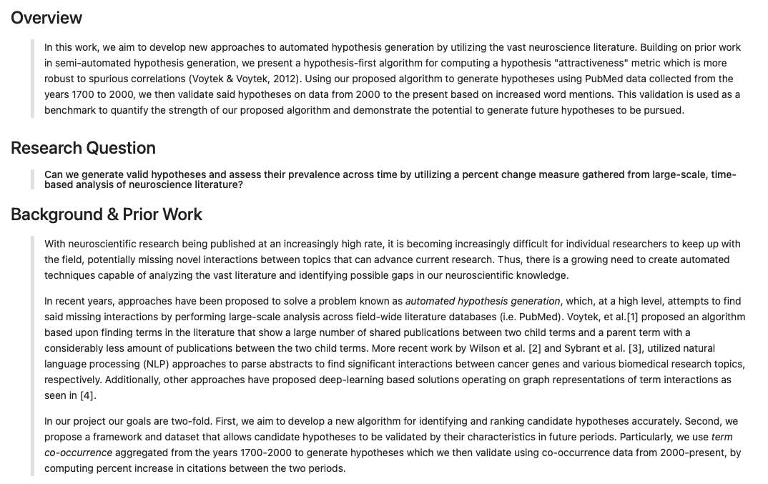
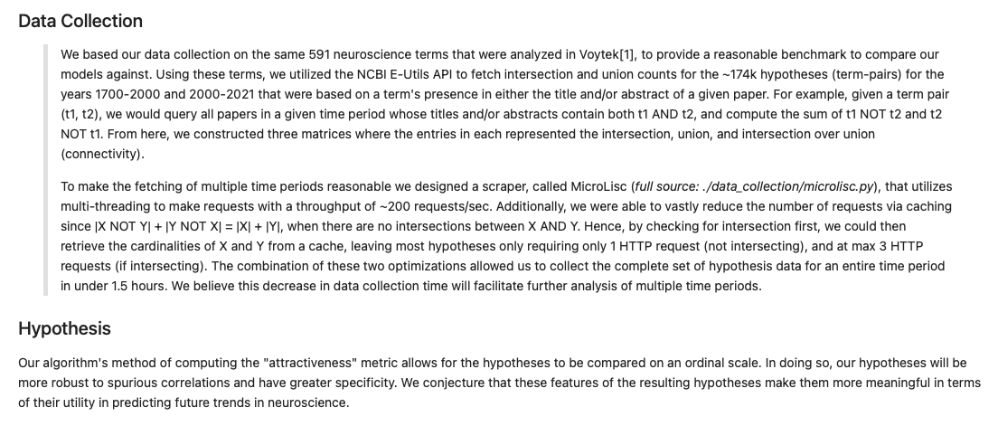
Final Project
https://github.com/NeuralDataScience/Projects/blob/main/Wi2021/FinalNotebookGroup-TextMining.ipynb
Notes:
https://github.com/NeuralDataScience/Projects/blob/main/Wi2021/FinalNotebookGroup-TextMining.ipynb
Check out this example and others on the github page

Slide 9
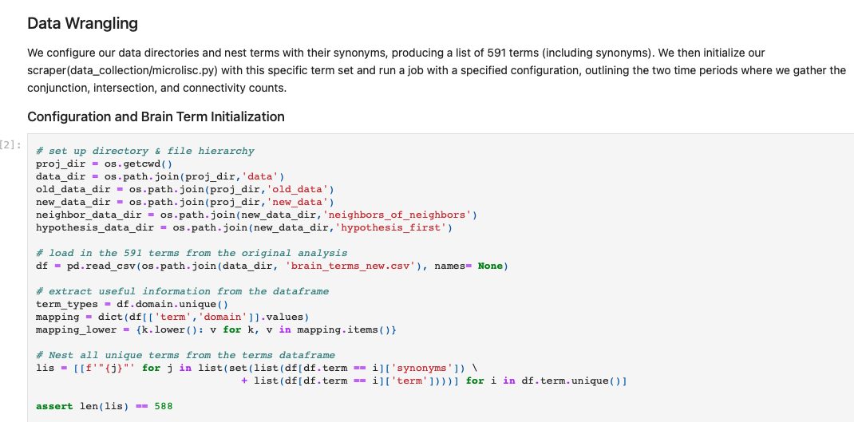
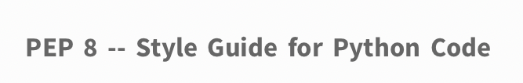
Final Project
https://github.com/NeuralDataScience/Projects/blob/main/Wi2021/FinalNotebookGroup-TextMining.ipynb
Notes:
https://github.com/NeuralDataScience/Projects/blob/main/Wi2021/FinalNotebookGroup-TextMining.ipynb
Good commenting and following PEP guidelines (https://www.python.org/dev/peps/pep-0008/)

Slide 10
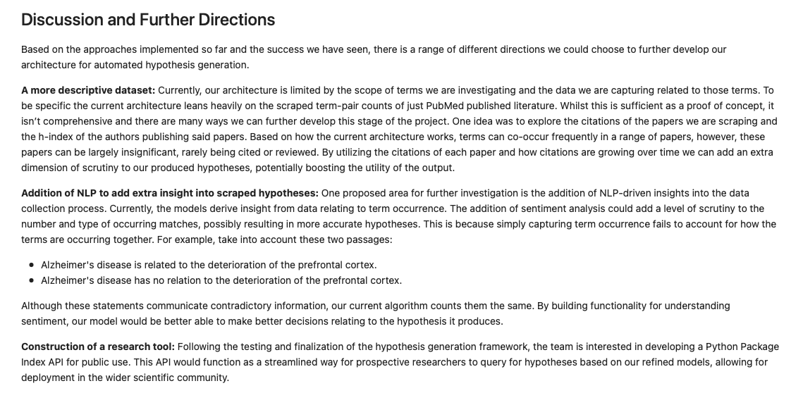
Final Project
https://github.com/NeuralDataScience/Projects/blob/main/Wi2021/FinalNotebookGroup-TextMining.ipynb
Notes:
https://github.com/NeuralDataScience/Projects/blob/main/Wi2021/FinalNotebookGroup-TextMining.ipynb
Acts similarly to a real scientific paper discussion
Think about what your results imply
QUESTION your results… what are potential pitfalls/weaknesses?
If you had all the time in the world, what else would you do with this project?

Slide 11
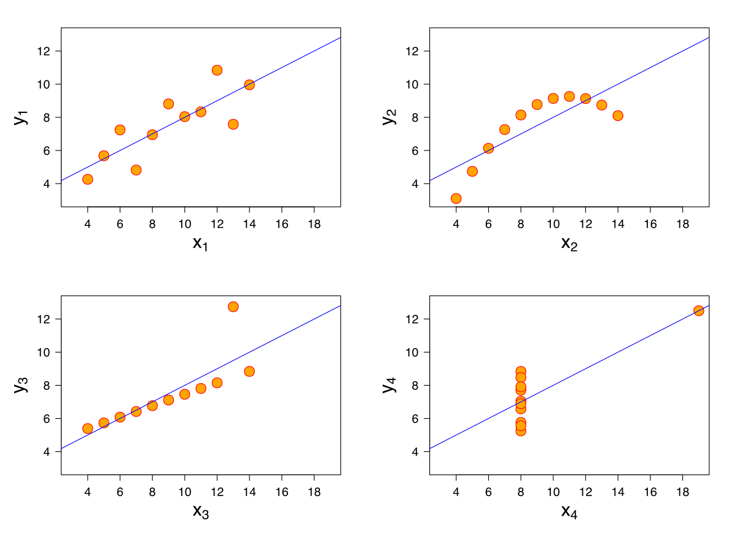
Brief Overview of A3 (released on datahub tomorrow)
Correlations
When should we vs. should we not use correlations in neuroscience research?
When is it possible to accidentally infer causality from correlation?
Tools you’ll be using:
Matplotlib (plotting library)
Seaborn (data viz library)
Scipy (stats library)
https://seaborn.pydata.org
https://matplotlib.org
https://scipy.org

Slide 12
General Announcements and Reminders
Reading Quiz due this Friday (2/4/22) at 11:59 PM (PST)
Three attempts
We will grade your last attempt, not your best attempt
A3 due next Friday (2/11/22) at 11:59 PM (PST)
Released on datahub tomorrow
Post on slack about questions

